Slide 1



Fixit@KPRCAS
Problem Statement ID – PS02
Problem Statement Title – Chatbot for KPRCAS website
Team Name – AURON
Team Leader Name – Dhaarani D
Team Leader Contact - 9159133888
01

Slide 2
AURON
Features
Instant & Accurate Responses – Answers queries using predefined rules.
Campus Assistance – Provides info on admissions, placements, staff, and navigation.
Multilingual Support – Communicates in multiple languages for better accessibility.
Voice Assistance for Disabled Users – Ensures inclusivity for visually impaired users.
Easy Customization – Can be updated with new queries.
Lightweight & Fast – Works efficiently without AI training.
Consistent & Reliable – Ensures structured and accurate replies.
Scalable & Future-Ready – Can expand or integrate with AI.
Revenue Potential – Can collaborate with public institutions for income generation.
Idea/Prototype Overview
The rule-based chatbot for KPRCAS is designed to assist students, parents, and visitors.
It provides instant responses to queries related to admissions, placements, staff details, department insights, and campus navigation.
Acts as a virtual guide, making information easily accessible.
Operates on predefined rules and keyword matching, ensuring quick, consistent, and accurate answers
Does not require AI training or complex data processing, making it efficient and easy to implement.
02

Slide 3

AURON
Methodology and Process for Implementation
Requirement Analysis: Identify common queries (e.g., admissions, placements, campus facilities) to design a suitable chatbot response system.
Design Chatbot Flow: Create predefined question-answer pairs using a rule-based approach with keyword matching.
Develop UI: Build a simple web interface with HTML, and JavaScript for user interaction.
Backend Logic: Implement response logic using JavaScript, matching user input with predefined keywords.
Testing and Refining: Test for accurate responses and refine the chatbot based on feedback.
Deployment: Host the chatbot on cloud platforms or local servers for public access.
Technologies to be Used
Frontend: HTML, JavaScript
Backend (Optional): Node.js,
UI/UX Design: Responsive design principles
Hosting: Heroku, or GitHub Pages
03

Slide 4
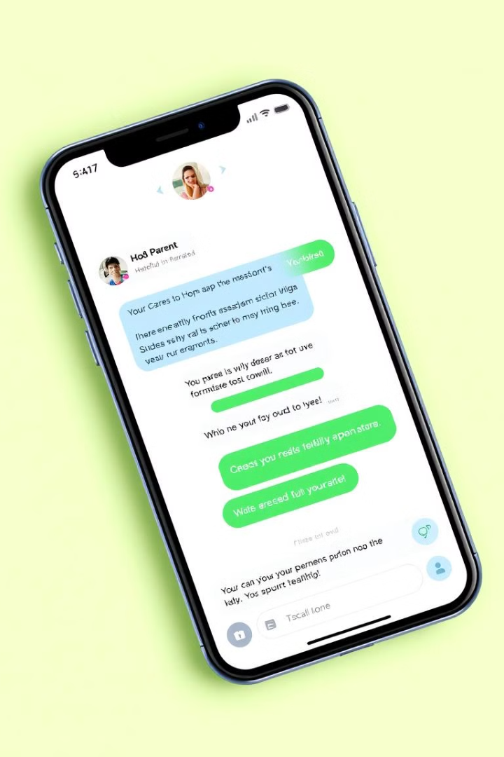
AURON
Pros
Fast & Reliable – Provides instant responses based on predefined rules.
No Training Required – Works without AI model training.
Easy Implementation – Simple logic and decision trees.
Highly Customizable – Can be tailored for different queries.
Cons
Limited Understanding – Cannot handle complex or unknown queries.
No Learning Ability – Does not improve over time like AI-based chatbots.
Rule Maintenance – Requires manual updates for new queries.
Uniqueness
Specifically designed for KPRCAS, catering to student and visitor needs.
Provides structured and accurate information without requiring internet-based AI.
Can be integrated into a humanoid robot (Auron) for enhanced interaction.
Innovation
Future enhancement: Auron – A Miniature Humanoid Assistant with a built-in chatbot and display screen for better engagement.
Potential upgrade to AI-powered chatbot for smarter interactions.
Integration with voice recognition and gesture control for a seamless user experience.
04

Slide 5
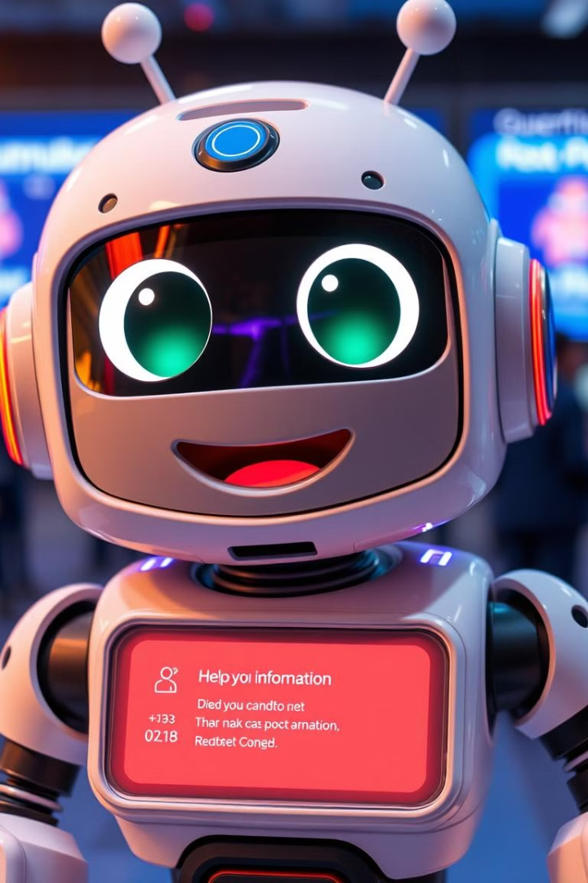
AURON
Material and making cost
A miniature humanoid robot designed to assist visitors at KPRCAS.
Provides guidance to classrooms, admin office, placements, etc.
Processing Unit (Raspberry Pi 4 / Arduino Mega) 5,000 – 6,500
3D-Printed Body (PLA Filament + Printing) 2,000 – 3,500
Servo Motors (6-10 units, e.g., MG995 / SG90) 2,000 – 4,000
Touchscreen Display (5-7 inch LCD) 3,500 – 5,000
Speaker & Microphone Module 1,000 – 2,000
Camera Module (Optional) 1,500 – 3,000
Battery & Power Supply (Li-ion / Adapter) 1,500 – 2,500
Sensors (Ultrasonic, IR, etc.) 1,000 – 2,000
Wires, Connectors, and Miscellaneous 1,000 – 2,000\
Inbuilt rule-based chatbot for answering queries
Touchscreen display on the chest for visual guidance
Voice recognition for user interaction
Compact (30-60 cm) and portable design
AI & ML (Rule-based chatbot), Python (Flask), 3D Modeling, Embedded Systems
05

Slide 6
AURON
Team Details
S.No | Team Details | Department | Year of Study | Mobile Number
1 | Team Leader Name | Dhaarani D | I | 9159133888
2 | Team Member 1 | Karthika K | I | 9585050407
3 | Team Member 2 | Dhivya K | I | 9600607215
4 | Team Member 3 | Sasvith D | I | 9345510364
5 | Team Member 4 | Nithin N | I | 8778595716
6 | Team Member 5 | Kamalesh R | I | 6369353513
S.No | Mentor Details | Department | Mobile Number | Email ID
1 | Mentor 1 (Optional) | Dr. P Kavipriya | 9994180320 | kavipriya.p@kprcas.ac.in
2 | Mentor 2 (Optional) | Dr. S Janani | 8220236346 | janani.s@kprcas.ac.in
06

